Slide 1

Introduction
The Prediction of Airbnb on a weekly basis to realize the price trend.
Airbnb is an online platform like a marketplace of accommodation which matches the needs of staying and of lending.
It is used for short-term homestays. Airbnb acts as a broker and charges a commission from each booking they get.
The regression algorithm is used to predict the weekly trend where the listing prices in the weekend are higher than weekdays.
The project will give answers to the following questions:
How long is the period available for lending by rooms?
Is there a busy season? And so on.

Slide 2
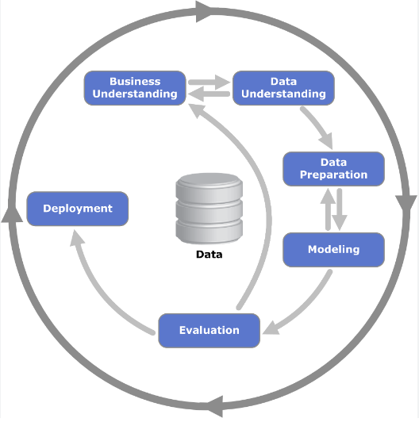
Standard Process: CRISP-DM
We will use the CRISP-DM to understand the underlying problem and to solve it.
CRISP-DM, which stands for Cross-Industry Standard Process for Data Mining, is an industry-proven way to guide your data mining efforts.

Slide 3
Business/Research Understanding phase
In this project we focus on the Prediction of Airbnb on a weekly basis to realize the price trend.
The regression algorithm is used to predict the weekly trend where the listing prices in the weekend are higher than weekdays.
The project will give answers to the following questions: How long is the period available for lending rooms? Is there rooms which is available all for years? Here, We want to know the trend in the outline of the data.
We can help the business to upscale by knowing the traffic. Business can profit by understanding the demand and take proper steps to fulfil the demand.
Another answer our project will give is by answering questions like are there any trends of popular rooms? If this question's answer is true, we can suggest host to ways make the room easier to rent.

Slide 4
DATA SOURCE
The dataset is referred from Kaggle. This dataset is part of Airbnb Inside
Since 2008, guests and hosts have used Airbnb to travel in a more unique, personalized way. As part of the Airbnb Inside initiative, this dataset describes the listing activity of homestays in Seattle, WA.
Here in this aribnb project there are 3 available data.
Listings: Including thorough descriptions and the overall rating of the reviews .
Calendar: Containing the listing id and the price and availability for that day
Reviews: Each reviewer has their own unique ID and also there are extensive remarks.

Slide 5
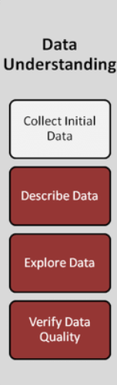
Data Understanding
Attributes listing:
The main attributes used in this scenario are as follows:
review_scores_rating :
This attribute is bascially the reviews given to the property. The ratings
and score are analysed.
Price:
This is the total amount that airbnb takes per 1 night stay or how
many ever days the client wants to do their bookings.
maximum_nights:
This is the number of nights the customer wants to book a
particular property associated with airbnb.

Slide 6

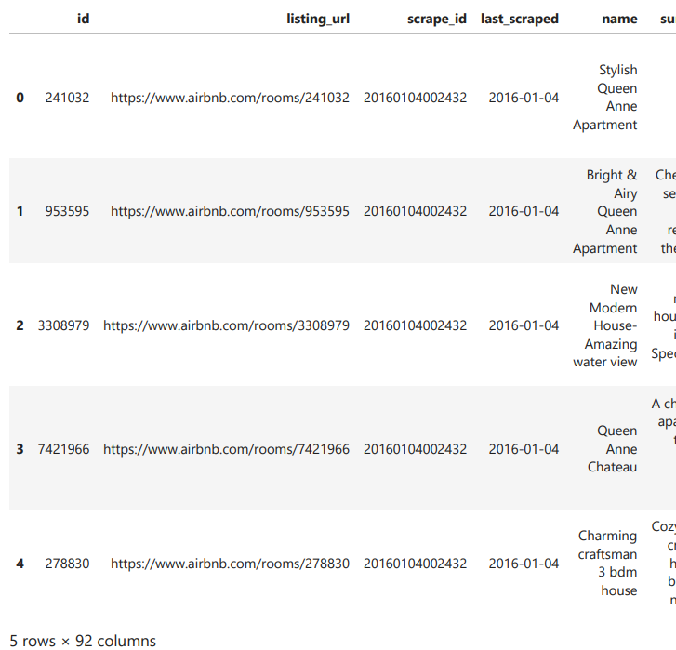
Sample data
Lets see the first 5 rows:

Slide 7
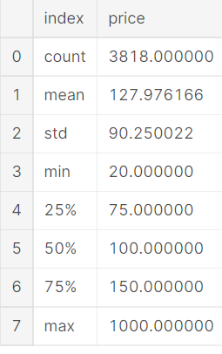
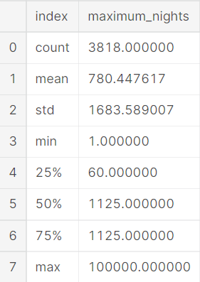
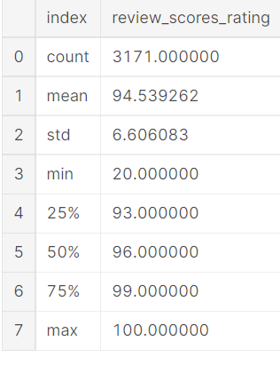
Sample data of Attributes
Reviewing score sample data:
Price sample data
Maximum nights sample data

Slide 8
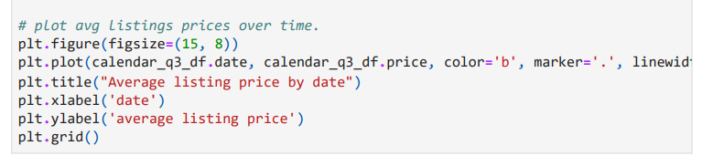
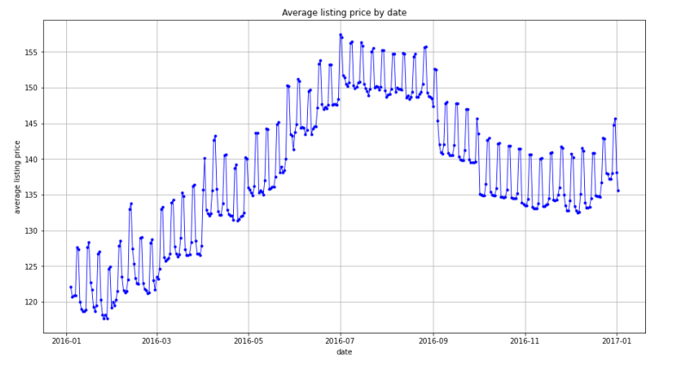
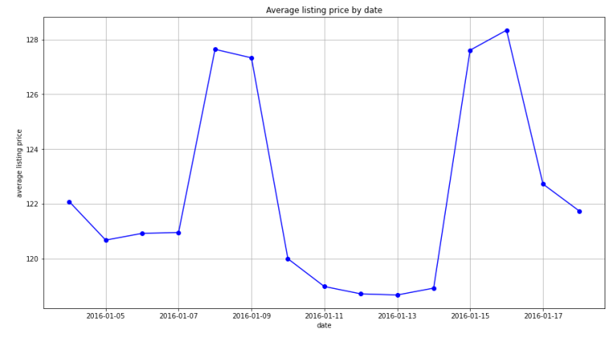
Data Understanding Outputs
There are two trend of the data.
The average price rise from 2016/1 to 2016/7, and reach peak for three months. We can also see that the Average from 2017-01 is higher than 2016-01.
There is periodic small peak.
Trend of the listings price

Slide 9
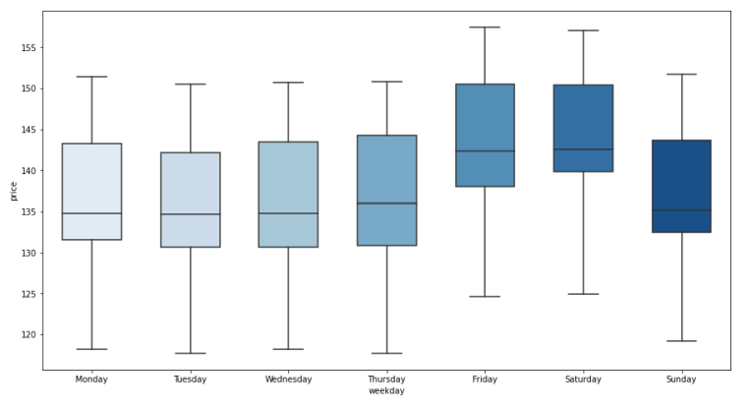
Data Understanding Outputs
Here we can find out which weekday has high price. So we conclude that the friday and saturday have the highest price.

Slide 10
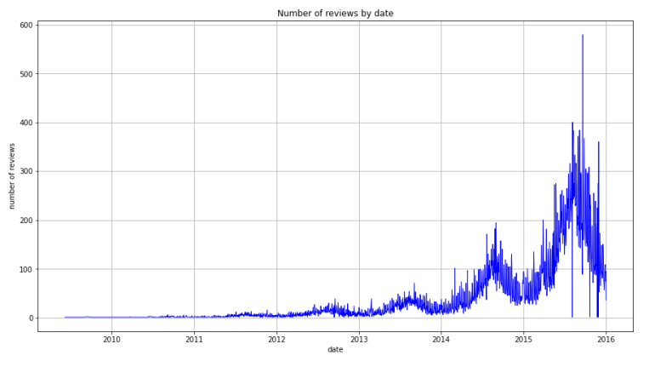
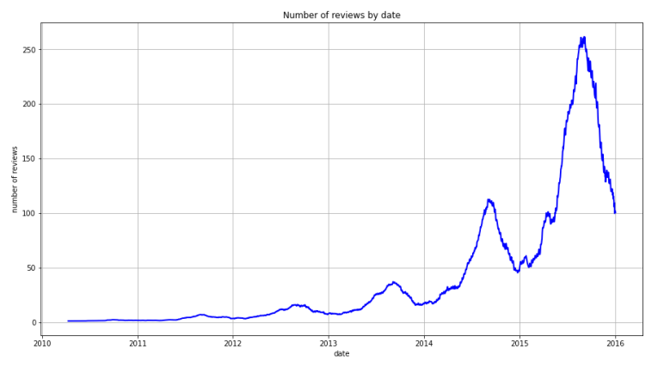
Data Understanding Outputs
we can see an increase in the number of Airbnb users. (and the date range is wide than calendar data)
And I realize it seems to have a peak at about the same time of each year. These reviews can help airbnb improve application.
Average of no of reviews over time

Slide 11
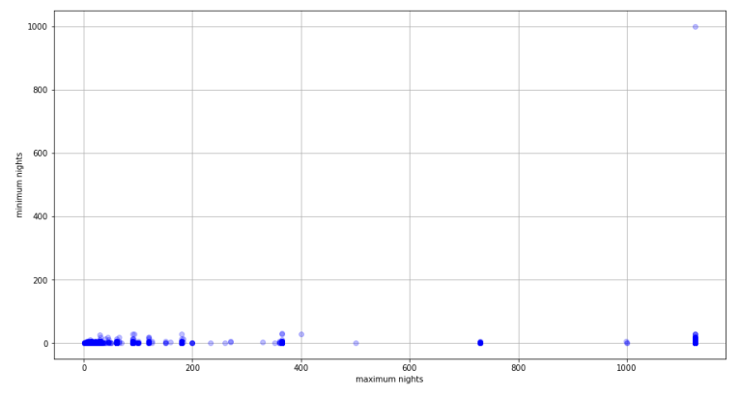
Data Understanding Outputs
How long is the period available for lending by rooms? To answer this we have plot a scatter plot of maximum nights and minimum nights.
From here, it can be seen that the minimum nights is almost constant regardless of the maximum nights

Slide 12
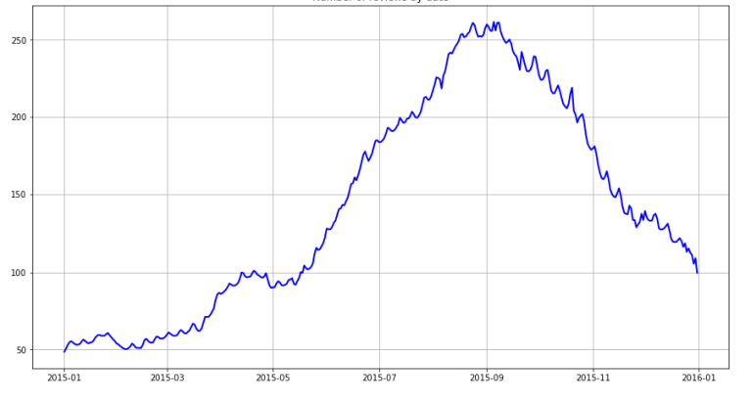
Data Understanding Outputs
To answer the question Is there a busy season? From this graph we can clearly say that the busy season is One month before and after from September.

Slide 13
Data Modeling (Random Forest Regression)
This model uses Random Forest Algorithm for the training process
Let us first understand few basic definitions
Decision Trees -
can be used for both classification and regression
data is split according to a particular parameter
two entities present - a leaf and a node
Ensemble learning method -
taking average of predictions taken from multiple models which are trained separately with the same data
Random Forest -
supervised learning algorithm
based pm ensemble learning and multiple decision trees

Slide 14
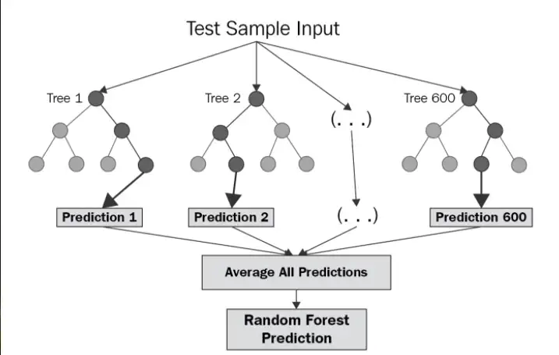
As we can see in the diagram, there are main four steps taking place -
Randomly we need to select k data-points from the dataset
Then, we need to build decision tree based on these parameters
Select the number of trees N, which is 5 in our case.
Each tree predicts the value of y. Then we need to take average of all of these predictions.

Slide 15
Data Preparation
"Are there any trends of popular rooms?".
In the Data Preparation Phase, the final data set is extracted from the initial data and redundant data is removed.
● To process the results, data needs to be accurate and clean.
● The part from here will start giving the answer for, ‘Are there any trends of popular rooms?’
● To begin the cleaning and processing of listing data, we first define the target variable ‘Popular of listings’
)

Slide 16
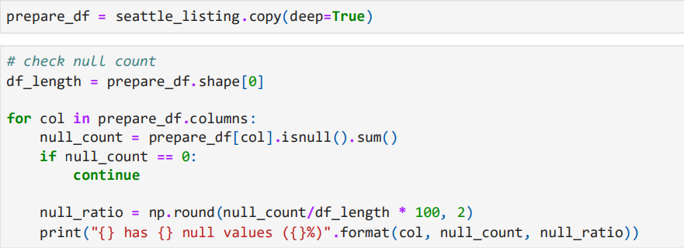
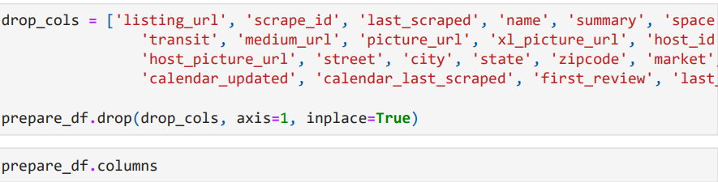

Slide 17
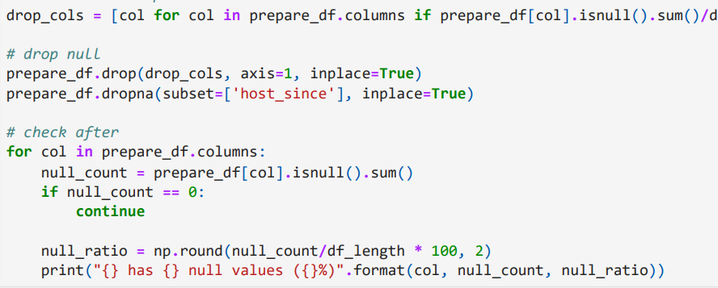
● The variable is defined as [Actual number of times rent] / ([Available days from 2016 to 2017] * (2017 - [Year of the listings open])

Slide 18
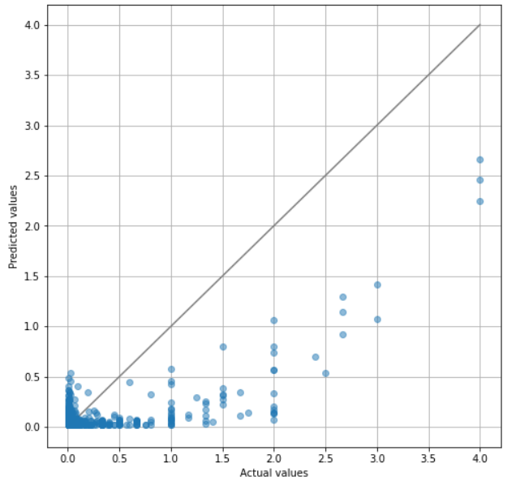
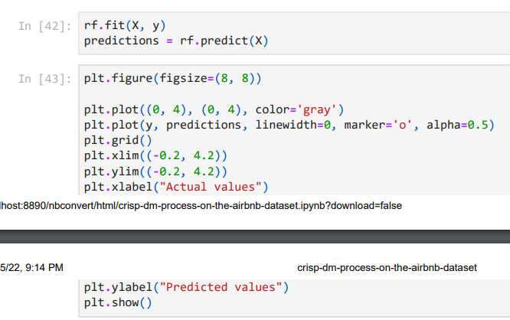
Evaluation
Using random forest regressor we have plotted the scatter plot of predicted and actual values. The closer to the gray line, the more accurate the predicted value is.

Slide 19
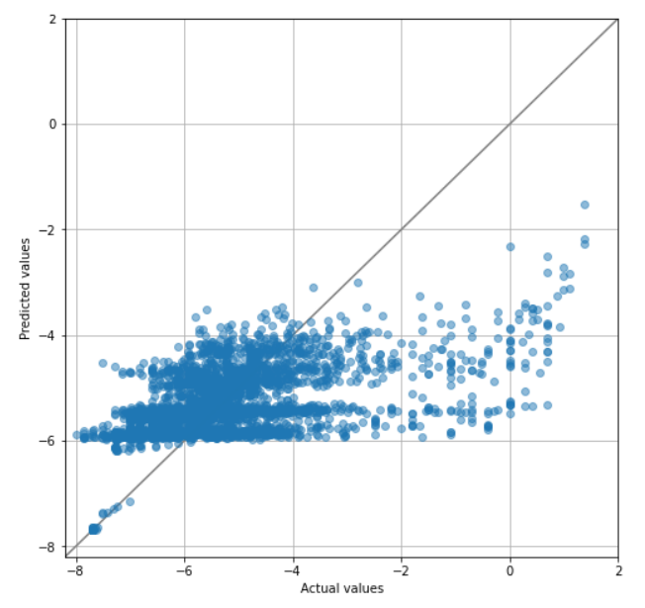
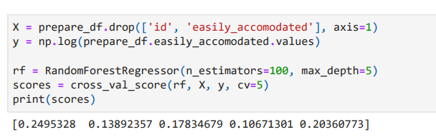
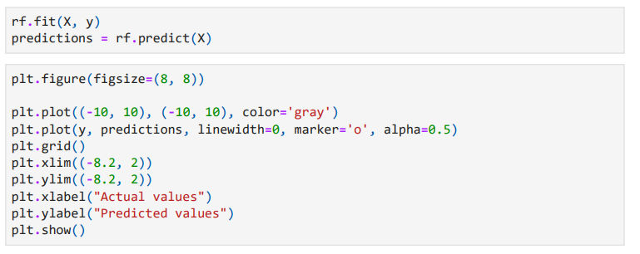
Evaluation
logarithmic transformation of the target variable.

Slide 20
Deployment
Deployment is the final step of the CRISP-DM process
After the result is obtained, a report will be made and checked against the objectives which are made during the initial phase.
This model is getting used to understand the trends in the bookings of Airbnb hotels/apartments.
This will help the firm understand the patterns of the data
Having a better understanding of the data will increase the chances of making better decisions for future and hence will increase the revenue of the firm

Slide 21
Conclusion
Using the Random Forest Regressor on the airbnb data from the Seattle area, analysis has been done.
We found that at the same time each year, there is increase in the number of users and their reviews.
Also the maximum span of stay is around three years or more and minimum span is around two days.
The histogram also suggests the maximum number of nights within a week.

Slide 22
References
https://www.kaggle.com/datasets/airbnb/seattle/download?datasetVersionNumber=2 – DATASET LINK
https://en.wikipedia.org/wiki/Airbnb

Slide 23


